Slide 1

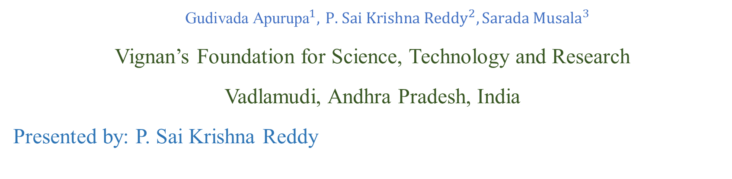
Energy Efficient Approximate Adders Using CNFET
${\text{Gudivada} \text{Apurupa}}^{1},$ ${\text{P}\text{. }\text{Sai} \text{Krishna} \text{Reddy}}^{2},{\text{Sarada} \text{Musala}}^{3}$
Vignan’s Foundation for Science, Technology and Research
Vadlamudi, Andhra Pradesh, India
Presented by: P. Sai Krishna Reddy

Slide 2
CONTENTS
Introduction
Existing Approximate Adder Circuits
Proposed Approximate Adder Circuits
Simulation Results of Proposed Approximate Adders
PDP comparison of Existing Adders and Proposed Adders
Conclusion
References

Slide 3
INTRODUCTION
Approximate Computing is used to trade off the strict computing correctness of conventional full adder for better performance and energy efficiency of the digital computer system.
Approximate adders allow operating in parallel for high speed and energy efficiency with an existing chance of incorrect results.
Approximate Adders are mainly used for Image processing, Audio, Video Processing, and Machine learning applications.
The Carbon Nanotube Field Effect Transistor (CNFET) is used widely in nanotechnologies in place of MOSFETs. These comprise of two types P- type CNFET and n-type CNFET.
The CNTFETs are one-atom-thick layer graphene tubes that are transformed into cylindrical pipes. As compared to MOSFETs switching speed is high for CNTFETs.

Slide 4
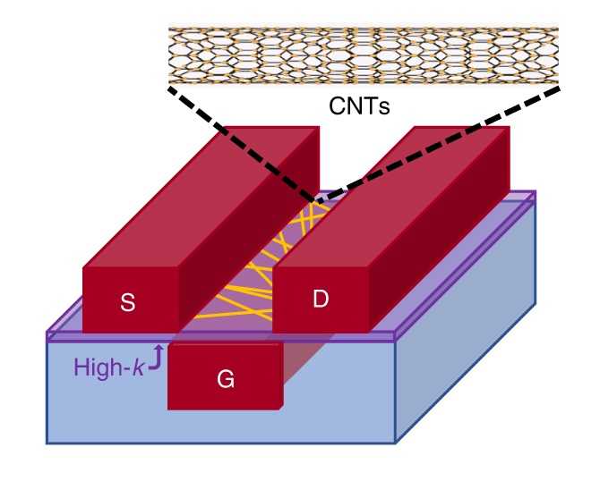
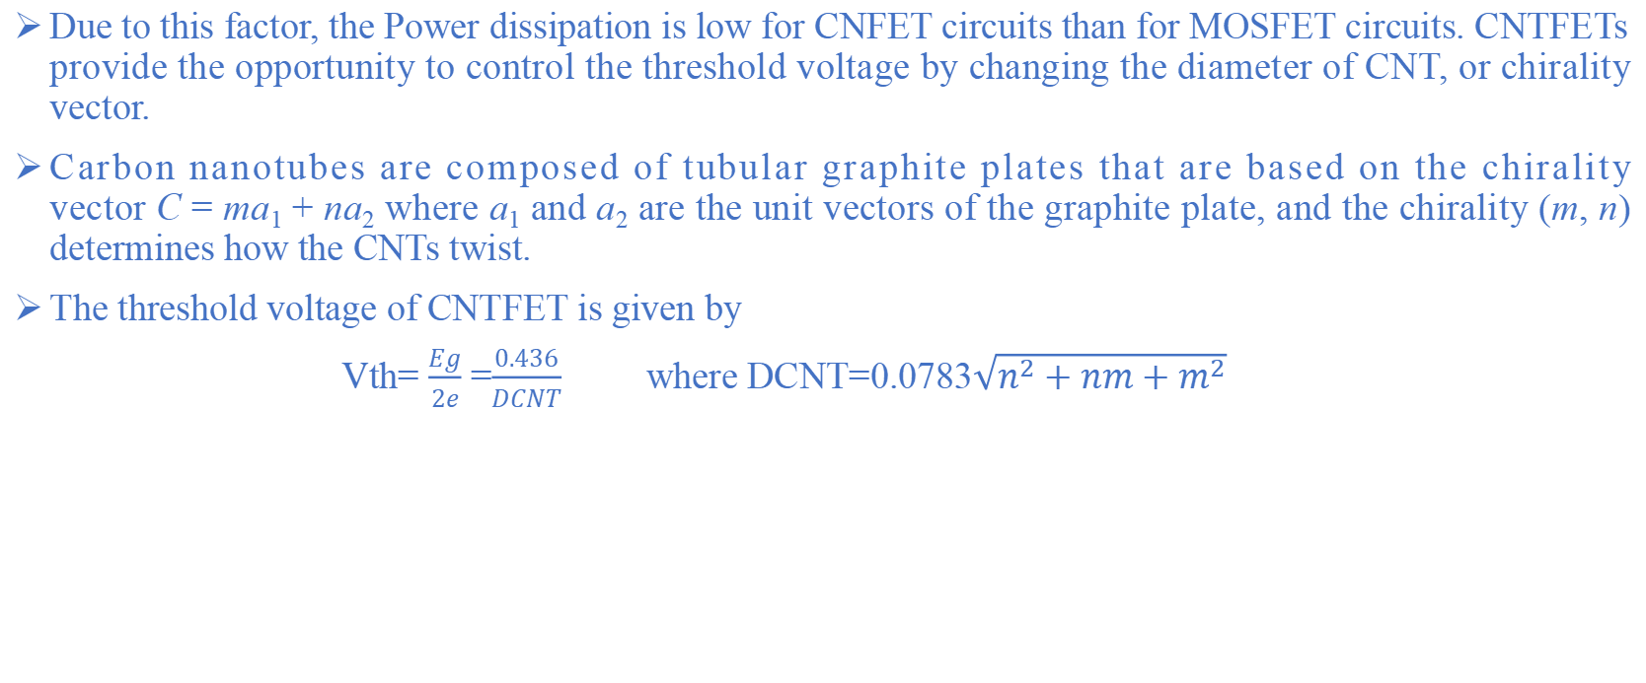
Cont..
Due to this factor, the Power dissipation is low for CNFET circuits than for MOSFET circuits. CNTFETs provide the opportunity to control the threshold voltage by changing the diameter of CNT, or chirality vector.
Carbon nanotubes are composed of tubular graphite plates that are based on the chirality vector C = ma₁ + na₂ where a₁ and a₂ are the unit vectors of the graphite plate, and the chirality (m, n) determines how the CNTs twist.
The threshold voltage of CNTFET is given by
Vth= $\frac{Eg}{2e}$ =$\frac{0.436}{DCNT}$ where DCNT=0.0783$\sqrt{n^{2}+nm+m^{2}}$
Fig.1: Structure CNTFET

Slide 5
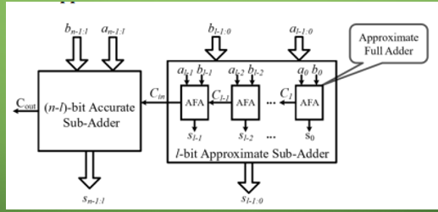
Cont..
Fig.2:Approximate Computing
5

Slide 6
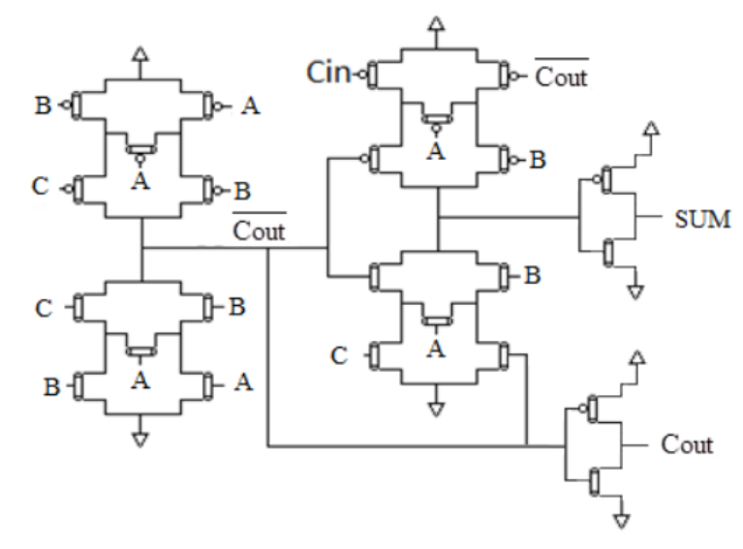
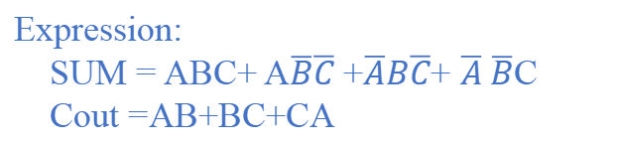
Exact Full Adder Circuit
Expression:
SUM = ABC+ A$\overline{B}\overline{C}$ +$\overline{A}B\overline{C}$+ $\overline{A} \overline{B}$C
Cout =AB+BC+CA
No. of transistors: 24
Truth table of Exact Full Adder
A | B | Cin | SUM | Cout
0 | 0 | 0 | 0 | 0
0 | 0 | 1 | 1 | 0
0 | 1 | 0 | 1 | 0
0 | 1 | 1 | 0 | 1
1 | 0 | 0 | 1 | 0
1 | 0 | 1 | 0 | 1
1 | 1 | 0 | 0 | 1
1 | 1 | 1 | 1 | 1
Fig.3: Exact Full Adder
[1] Ghorbani, Ali & Ghorbani, Ghazaleh. (2014). Energy Efficient Full Adder Cell Design With Using Carbon Nanotube Field Effect Transistors In 32 Nanometer Technology. International Journal of VLSI Design & Communication Systems. 5. 10.5121/vlsic.2014.5501.
6

Slide 7
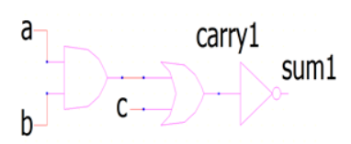
Existing Approximate Adder Circuits
Approximate Adder 1
Truth Table for AA1
A | B | C | Sum | Carry
0 | 0 | 0 | 1 | 0
0 | 0 | 1 | 0 | 1
0 | 1 | 0 | 1 | 0
0 | 1 | 1 | 0 | 1
1 | 0 | 0 | 1 | 0
1 | 0 | 1 | 0 | 1
1 | 1 | 0 | 0 | 1
1 | 1 | 1 | 0 | 1
Fig.4:Approximate Adder-1
No. of transistors : 14
Expression:
Sum1=~Carry1;
Carry1=(a. b)+c
[2]:M. Ramasamy, G. Narmadha and S. Deivasigamani, “Carry based approximate full adder for low power approximate computing,” 7th International Conference on Smart Computing & Communications (ICSCC), pp. 1-4, 2019.

Slide 8
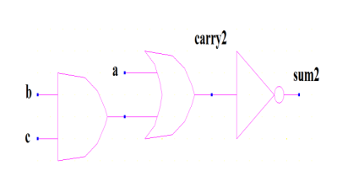
Approximate Adder 2
Truth Table for AA2
A | B | C | Sum | Carry
0 | 0 | 0 | 1 | 0
0 | 0 | 1 | 1 | 0
0 | 1 | 0 | 1 | 0
0 | 1 | 1 | 0 | 1
1 | 0 | 0 | 0 | 0
1 | 0 | 1 | 0 | 1
1 | 1 | 0 | 0 | 1
1 | 1 | 1 | 0 | 1
Fig.5:Approximate Adder-2
No. of transistors : 14
Expression:
Sum2=~Carry2;
Carry2=(b. c)+a
[2] M. Ramasamy, G. Narmadha and S. Deivasigamani, “Carry based approximate full adder for low power approximate computing,” 7th International Conference on Smart Computing & Communications (ICSCC), pp. 1-4, 2019.

Slide 9
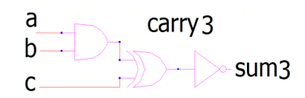
Approximate Adder 3
Truth Table for AA3
A | B | C | Sum | Carry
0 | 0 | 0 | 1 | 0
0 | 0 | 1 | 0 | 1
0 | 1 | 0 | 1 | 0
0 | 1 | 1 | 0 | 1
1 | 0 | 0 | 1 | 0
1 | 0 | 1 | 0 | 1
1 | 1 | 0 | 0 | 1
1 | 1 | 1 | 1 | 0
Fig.6:Approximate Adder-3
No. of transistors : 18
Expression:
Sum3=~Carry3;
Carry3=(a. b)^c
[2]: M. Ramasamy, G. Narmadha and S. Deivasigamani, “Carry based approximate full adder for low power approximate computing,” 7th International Conference on Smart Computing & Communications (ICSCC), pp. 1-4, 2019.

Slide 10
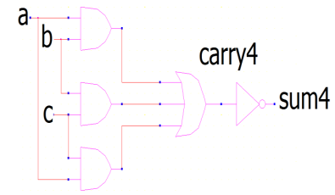
Approximate Adder 4
Truth Table for AA4
A | B | C | Sum | Carry
0 | 0 | 0 | 1 | 0
0 | 0 | 1 | 1 | 0
0 | 1 | 0 | 1 | 0
0 | 1 | 1 | 0 | 1
1 | 0 | 0 | 1 | 0
1 | 0 | 1 | 0 | 1
1 | 1 | 0 | 0 | 1
1 | 1 | 1 | 0 | 1
Fig.7:Approximate Adder-4
No. of transistors : 14
Expression:
Sum4=~Carry4;
Carry4=ab+bc+ca
[2]: M. Ramasamy, G. Narmadha and S. Deivasigamani, “Carry based approximate full adder for low power approximate computing,” 7th International Conference on Smart Computing & Communications (ICSCC), pp. 1-4, 2019.

Slide 11
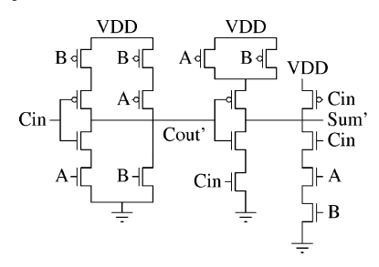
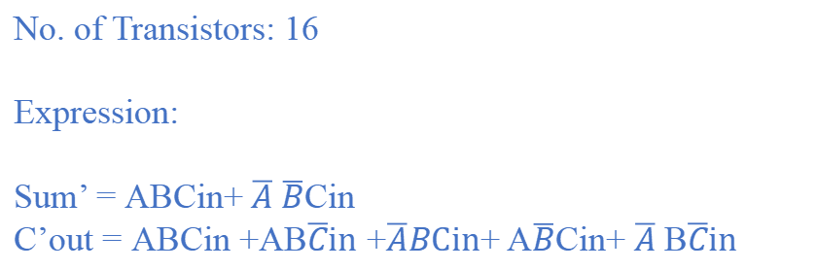
Approximate Adder 5
Truth Table for AA5
A | B | C | Sum | Carry
0 | 0 | 0 | 0 | 0
0 | 0 | 1 | 1 | 0
0 | 1 | 0 | 0 | 1
0 | 1 | 1 | 0 | 1
1 | 0 | 0 | 0 | 0
1 | 0 | 1 | 0 | 1
1 | 1 | 0 | 0 | 1
1 | 1 | 1 | 1 | 1
Fig.4:Approximate Adder-1
Fig.8:Approximate Adder-5
No. of Transistors: 16
Expression:
Sum’ = ABCin+ $\overline{A} \overline{B}$Cin
C’out = ABCin +AB$\overline{C}in$ +$\overline{A}BCin$+ A$\overline{B}$Cin+ $\overline{A}$B$\overline{C}in$
[3]: V. Gupta, D. Mohapatra, A. Raghu Nathan, and K. Roy, “Low-power digital signal processing using approximate adders,” IEEE Trans. OnComputer-Aided Design of Integrated Circuits and Systems, vol. 32,no. 1, pp. 124–137, Jan. 2013.

Slide 12
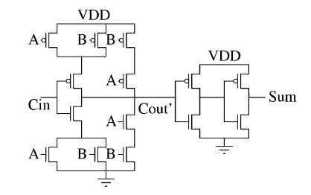
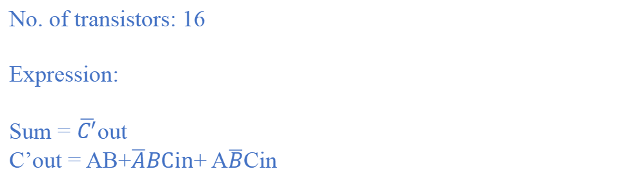
Approximate Adder 6
Truth Table for AA6
A | B | C | Sum | Carry
0 | 0 | 0 | 1 | 0
0 | 0 | 1 | 1 | 0
0 | 1 | 0 | 1 | 0
0 | 1 | 1 | 0 | 1
1 | 0 | 0 | 1 | 0
1 | 0 | 1 | 0 | 1
1 | 1 | 0 | 0 | 1
1 | 1 | 1 | 0 | 1
Fig.9:Approximate Adder-6
No. of transistors: 16
Expression:
Sum = $\overline{C^{′}}$out
C’out = AB+$\overline{A}BCin$+ A$\overline{B}$Cin
[3]: V. Gupta, D. Mohapatra, A. Raghu Nathan, and K. Roy, “Low-power digital signal processing using approximate adders,” IEEE Trans. OnComputer-Aided Design of Integrated Circuits and Systems, vol. 32,no. 1, pp. 124–137, Jan. 2013.

Slide 13
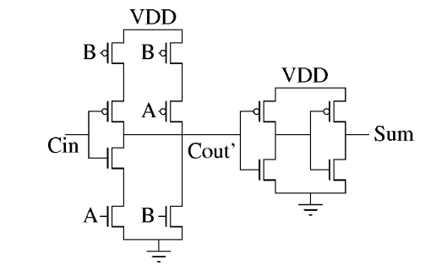
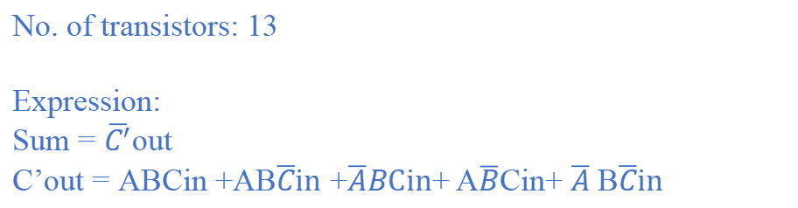
Approximate Adder 7
Truth Table for AA7
A | B | C | Sum | Carry
0 | 0 | 0 | 1 | 0
0 | 0 | 1 | 1 | 0
0 | 1 | 0 | 0 | 1
0 | 1 | 1 | 0 | 1
1 | 0 | 0 | 1 | 0
1 | 0 | 1 | 0 | 1
1 | 1 | 0 | 0 | 1
1 | 1 | 1 | 0 | 1
Fig.6:Approximate Adder-3
Fig.10:Approximate Adder-7
No. of transistors: 13
Expression:
Sum = $\overline{C^{′}}$out
C’out = ABCin +AB$\overline{C}in$ +$\overline{A}BCin$+ A$\overline{B}$Cin+ $\overline{A}$B$\overline{C}in$
[3]: V. Gupta, D. Mohapatra, A. Raghu Nathan, and K. Roy, “Low-power digital signal processing using approximate adders,” IEEE Trans. OnComputer-Aided Design of Integrated Circuits and Systems, vol. 32,no. 1, pp. 124–137, Jan. 2013.

Slide 14
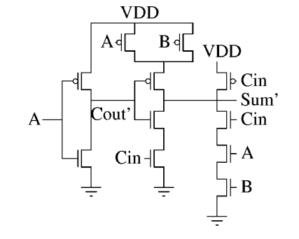
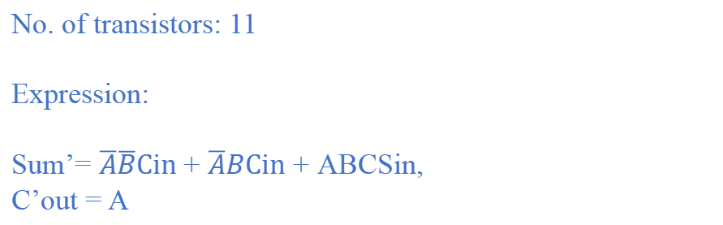
Approximate Adder 8
Truth Table for AA8
A | B | C | Sum | Carry
0 | 0 | 0 | 0 | 0
0 | 0 | 1 | 1 | 0
0 | 1 | 0 | 0 | 0
0 | 1 | 1 | 1 | 0
1 | 0 | 0 | 0 | 1
1 | 0 | 1 | 0 | 1
1 | 1 | 0 | 0 | 1
1 | 1 | 1 | 1 | 1
Fig.11:Approximate Adder-8
No. of transistors: 11
Expression:
Sum’= $\overline{A}\overline{B}Cin$+ $\overline{A}BCin$ + ABCSin,
C’out = A
[3]: V. Gupta, D. Mohapatra, A. Raghu Nathan, and K. Roy, “Low-power digital signal processing using approximate adders,” IEEE Trans. OnComputer-Aided Design of Integrated Circuits and Systems, vol. 32,no. 1, pp. 124–137, Jan. 2013.

Slide 15
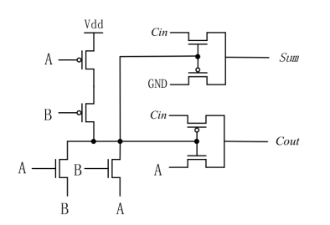
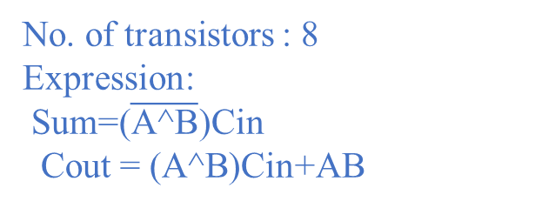
Approximate Adder 9
Truth Table for AA9
A | B | C | Sum | Carry
0 | 0 | 0 | 0 | 0
0 | 0 | 1 | 1 | 0
0 | 1 | 0 | 0 | 0
0 | 1 | 1 | 0 | 1
1 | 0 | 0 | 0 | 0
1 | 0 | 1 | 0 | 1
1 | 1 | 0 | 0 | 1
1 | 1 | 1 | 1 | 1
Fig.12:Approximate Adder-9
No. of transistors : 8
Expression:
Sum=($\overline{\text{A}\text{^}\text{B}}$)Cin
Cout = (A^B)Cin+AB
[4]: Z. Yang, A. Jain, J. Liang, J. Han and F. Lombardi, "Approximate XOR/XNOR-based adders for inexact computing," 2013 13th IEEE International Conference on Nanotechnology (IEEE-NANO 2013), 2013, pp. 690-693
15

Slide 16
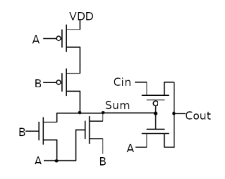
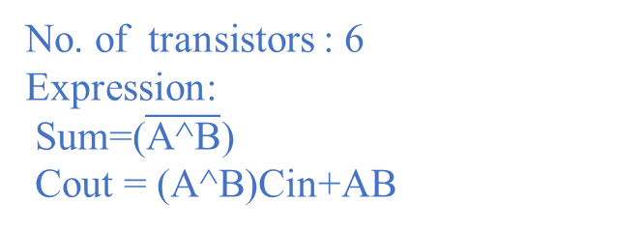
Approximate Adder 10
Truth Table for AA10
A | B | C | Sum | Carry
0 | 0 | 0 | 1 | 0
0 | 0 | 1 | 1 | 0
0 | 1 | 0 | 0 | 0
0 | 1 | 1 | 0 | 1
1 | 0 | 0 | 0 | 0
1 | 0 | 1 | 0 | 1
1 | 1 | 0 | 1 | 1
1 | 1 | 1 | 1 | 1
Fig.13:Approximate Adder-10
No. of transistors : 6
Expression:
Sum=($\overline{\text{A}\text{^}\text{B}}$)
Cout = (A^B)Cin+AB
[4]: Z. Yang, A. Jain, J. Liang, J. Han and F. Lombardi, "Approximate XOR/XNOR-based adders for inexact computing," 2013 13th IEEE International Conference on Nanotechnology (IEEE-NANO 2013), 2013, pp. 690-693
16

Slide 17
Table 1. Summary of Existing Approximate Adders
S.No | Approximate Adder | No. of Transistors | No. of Errors |  | Technology used
 |  |  | Sum | Carry
1 | Exact Adder | 24 | 0 | 0 | CMOS180nm
2 | AA1 | 14 | 3 | 1 | CMOS180nm
3 | AA2 | 14 | 3 | 0 | CMOS180nm
4 | AA3 | 18 | 2 | 2 | CMOS180nm
5 | AA4 | 14 | 2 | 0 | CMOS180nm
6 | AA5 | 16 | 2 | 1 | CMOS180nm
7 | AA6 | 16 | 2 | 0 | CMOS180nm
8 | AA7 | 13 | 3 | 1 | CMOS180nm
9 | AA8 | 11 | 3 | 2 | CMOS180nm
10 | AA9 | 13 | 2 | 0 | CMOS180nm
11 | AA10 | 10 | 2 | 0 | CMOS180nm
17

Slide 18
Proposed Approximate Adder Circuits
Approximate Adder 1
Truth Table for AA1
Vdd
Vdd
A | B | C | Sum | Carry
0 | 0 | 0 | 1 | 0
0 | 0 | 1 | 0 | 1
0 | 1 | 0 | 1 | 0
0 | 1 | 1 | 0 | 1
1 | 0 | 0 | 1 | 0
1 | 0 | 1 | 0 | 1
1 | 1 | 0 | 0 | 1
1 | 1 | 1 | 0 | 1
Vdd
A
Vdd
Vdd
B
C
A
Carry
Sum
C
B
GND
GND
GND
GND
GND
Fig.14: Approximate Adder-1
No. of transistors : 14
Expression:
Sum =~Carry
Carry =(A. B)+C

Slide 19
Approximate Adder 2
Vdd
Truth Table for AA2
Vdd
Vdd
A | B | C | Sum | Carry
0 | 0 | 0 | 1 | 0
0 | 0 | 1 | 1 | 0
0 | 1 | 0 | 1 | 0
0 | 1 | 1 | 0 | 1
1 | 0 | 0 | 0 | 0
1 | 0 | 1 | 0 | 1
1 | 1 | 0 | 0 | 1
1 | 1 | 1 | 0 | 1
B
Vdd
Vdd
C
A
B
Carry
Sum
A
C
GND
GND
GND
GND
GND
Fig.15: Approximate Adder-2
No. of transistors : 14
Expression:
Sum =~Carry
Carry =(B. C)+A

Slide 20
Approximate Adder 3
No. of transistors : 18
Expression:
Sum =~Carry;
Carry =(A. B)^C
Truth Table for AA3
Vdd
A | B | C | Sum | Carry
0 | 0 | 0 | 1 | 0
0 | 0 | 1 | 0 | 1
0 | 1 | 0 | 1 | 0
0 | 1 | 1 | 0 | 1
1 | 0 | 0 | 1 | 0
1 | 0 | 1 | 0 | 1
1 | 1 | 0 | 0 | 1
1 | 1 | 1 | 1 | 0
GND
Carry
Sum
GND
GND
C
GND
Fig.16: Approximate Adder 3

Slide 21
Approximate Adder 4
No. of transistors : 14
Expression:
Sum =~Carry;
Carry =AB+BC+CA
Vdd
A
B
Truth Table for AA4
B
A | B | C | Sum | Carry
0 | 0 | 0 | 1 | 0
0 | 0 | 1 | 1 | 0
0 | 1 | 0 | 1 | 0
0 | 1 | 1 | 0 | 1
1 | 0 | 0 | 1 | 0
1 | 0 | 1 | 0 | 1
1 | 1 | 0 | 0 | 1
1 | 1 | 1 | 0 | 1
C
Vdd
C
A
Carry
Sum
A
B
C
GND
B
C
A
GND
GND
GND
Fig.17: Approximate Adder 4

Slide 22
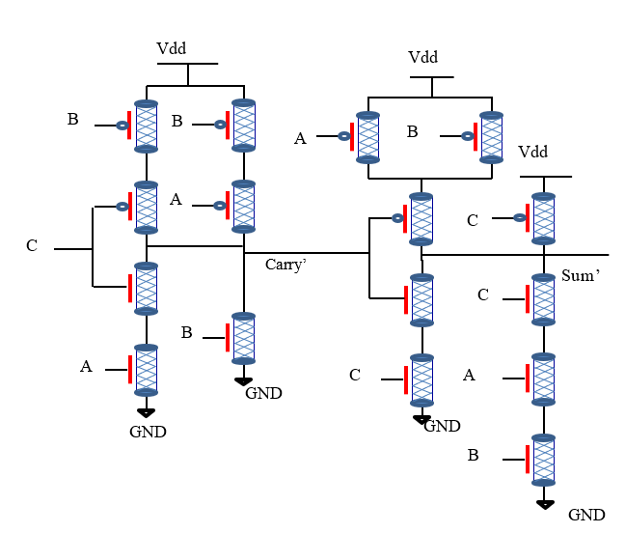
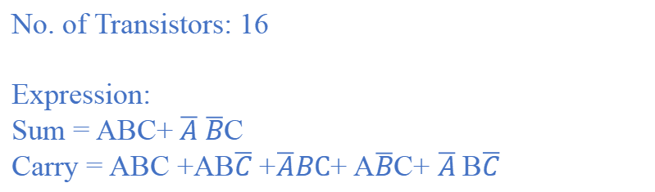
No. of Transistors: 16
Expression:
Sum = ABC+ $\overline{A} \overline{B}$C
Carry = ABC +AB$\overline{C}$ +$\overline{A}BC$+ A$\overline{B}$C+ $\overline{A}$B$\overline{C}$
Approximate Adder 5
Truth Table for AA5
A | B | C | Sum | Carry
0 | 0 | 0 | 0 | 0
0 | 0 | 1 | 1 | 0
0 | 1 | 0 | 0 | 1
0 | 1 | 1 | 0 | 1
1 | 0 | 0 | 0 | 0
1 | 0 | 1 | 0 | 1
1 | 1 | 0 | 0 | 1
1 | 1 | 1 | 1 | 1
Fig.18: Approximate Adder 5

Slide 23
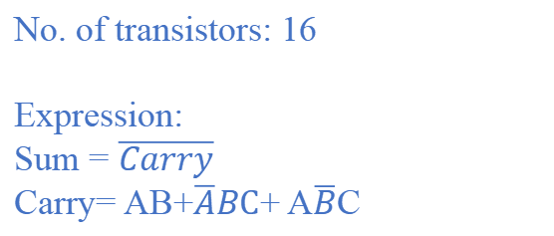
No. of transistors: 16
Expression:
Sum = $\overline{Carry}$
Carry= AB+$\overline{A}BC$+ A$\overline{B}$C
Approximate Adder 6
Vdd
A
B
B
Truth Table for AA6
Vdd
Vdd
A | B | C | Sum | Carry
0 | 0 | 0 | 1 | 0
0 | 0 | 1 | 1 | 0
0 | 1 | 0 | 1 | 0
0 | 1 | 1 | 0 | 1
1 | 0 | 0 | 1 | 0
1 | 0 | 1 | 0 | 1
1 | 1 | 0 | 0 | 1
1 | 1 | 1 | 0 | 1
A
Carry’
Sum
GND
GND
GND
Fig.19: Approximate Adder 6

Slide 24
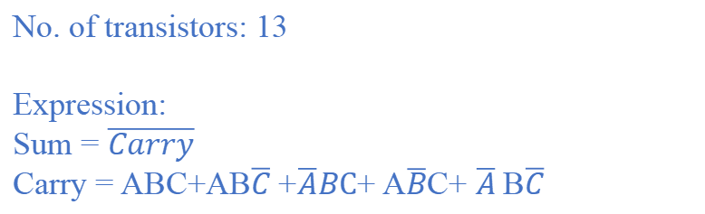
Approximate Adder 7
No. of transistors: 13
Expression:
Sum = $\overline{Carry}$
Carry = ABC+AB$\overline{C}$ +$\overline{A}BC$+ A$\overline{B}$C+ $\overline{A}$B$\overline{C}$
Vdd
B
Truth Table for AA7
B
A | B | C | Sum | Carry
0 | 0 | 0 | 1 | 0
0 | 0 | 1 | 1 | 0
0 | 1 | 0 | 0 | 1
0 | 1 | 1 | 0 | 1
1 | 0 | 0 | 1 | 0
1 | 0 | 1 | 0 | 1
1 | 1 | 0 | 0 | 1
1 | 1 | 1 | 0 | 1
Vdd
Vdd
A
C
Carry’
Sum
A
B
GND
GND
GND
Fig.20: Approximate Adder 7

Slide 25
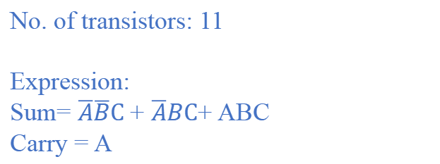
Approximate Adder 8
No. of transistors: 11
Expression:
Sum= $\overline{A}\overline{B}C$+ $\overline{A}BC$+ ABC
Carry = A
Vdd
B
A
Vdd
Truth Table for AA8
C
A | B | C | Sum | Carry
0 | 0 | 0 | 0 | 0
0 | 0 | 1 | 1 | 0
0 | 1 | 0 | 0 | 0
0 | 1 | 1 | 1 | 0
1 | 0 | 0 | 0 | 1
1 | 0 | 1 | 0 | 1
1 | 1 | 0 | 0 | 1
1 | 1 | 1 | 1 | 1
A
Carry’
Sum’
C
GND
C
A
GND
B
GND
Fig.21: Approximate Adder 8

Slide 26
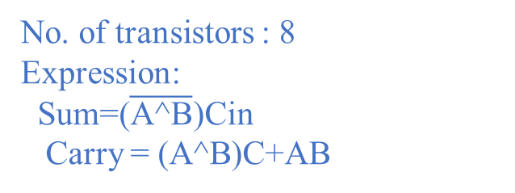
Approximate Adder 9
No. of transistors : 8
Expression:
Sum=($\overline{\text{A}\text{^}\text{B}}$)Cin
Carry = (A^B)C+AB
Vdd
GND
A
Sum
C
Truth Table for AA9
A | B | C | Sum | Carry
0 | 0 | 0 | 0 | 0
0 | 0 | 1 | 1 | 0
0 | 1 | 0 | 0 | 0
0 | 1 | 1 | 0 | 1
1 | 0 | 0 | 0 | 0
1 | 0 | 1 | 0 | 1
1 | 1 | 0 | 0 | 1
1 | 1 | 1 | 1 | 1
B
C
Carry
A
B
A
B
A
Fig.22: Approximate Adder 9

Slide 27
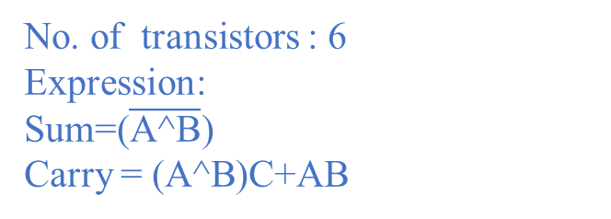
Approximate Adder 10
Vdd
A
Truth Table for AA10
B
A | B | C | Sum | Carry
0 | 0 | 0 | 1 | 0
0 | 0 | 1 | 1 | 0
0 | 1 | 0 | 0 | 0
0 | 1 | 1 | 0 | 1
1 | 0 | 0 | 0 | 0
1 | 0 | 1 | 0 | 1
1 | 1 | 0 | 1 | 1
1 | 1 | 1 | 1 | 1
C
Sum
Carry
A
B
A
B
Fig.23: Approximate Adder 10
No. of transistors : 6
Expression:
Sum=($\overline{\text{A}\text{^}\text{B}}$)
Carry = (A^B)C+AB

Slide 28
Table 2. Summary of Proposed Approximate Adders
S.No | Approximate Adder | No. of Transistors | No. of Errors |  | Technology used
 |  |  | Sum | Carry
1 | Exact Adder | 24 | 0 | 0 | CNTFET32nm
2 | AA1 | 14 | 3 | 1 | CNTFET32nm
3 | AA2 | 14 | 3 | 0 | CNTFET32nm
4 | AA3 | 18 | 2 | 2 | CNTFET32nm
5 | AA4 | 14 | 2 | 0 | CNTFET32nm
6 | AA5 | 16 | 2 | 1 | CNTFET32nm
7 | AA6 | 16 | 2 | 0 | CNTFET32nm
8 | AA7 | 13 | 3 | 1 | CNTFET32nm
9 | AA8 | 11 | 3 | 2 | CNTFET32nm
10 | AA9 | 8 | 2 | 0 | CNTFET32nm
11 | AA10 | 6 | 4 | 0 | CNTFET32nm
28

Slide 29
Simulation Results of Proposed Approximate Adders
e approximate
Table 3. Transistor count, Delay, Power and PDP of Proposed Adders
S. No. | Adders | No. of Transistors | Delay(ns) | Power(uw) | PDP(fJ)
1 | AA1 | 14 | 1.005 | 0.5602 | 0.563001
2 | AA2 | 14 | 1.498 | 0.5607 | 0.838246
3 | AA3 | 18 | 1.006 | 0.5078 | 0.574224
4 | AA4 | 14 | 1.005 | 0.4518 | 0.454059
5 | AA5 | 16 | 1.002 | 0.5609 | 0.562021
6 | AA6 | 16 | 1.006 | 0.4521 | 0.454812
7 | AA7 | 13 | 0.996 | 0.5609 | 0.558656
8 | AA8 | 11 | 1.504 | 0.4484 | 0.674393
9 | AA9 | 8 | 1.004 | 0.4389 | 0.440655
10 | AA10 | 6 | 1.449 | 0.4431 | 0.664206

Slide 30
PDP comparison of Existing Adders and Proposed Adders
Table 3. PDP comparison of Existing adders and Proposed Adders
S. No. | Adders | Existing Technology | PDP(fJ) | Proposed Technology | PDP(fJ)
1 | AA1 | gpdk180nm | 3.267398 | CNFET32nm | 0.563001
2 | AA2 | gpdk180nm | 5.333406 | CNFET32nm | 0.838246
3 | AA3 | gpdk180nm | 103.2987 | CNFET32nm | 0.574224
4 | AA4 | gpdk180nm | 43.08102 | CNFET32nm | 0.454059
5 | AA5 | gpdk180nm | 4.743280 | CNFET32nm | 0.562021
6 | AA6 | gpdk180nm | 1.341192 | CNFET32nm | 0.454812
7 | AA7 | gpdk180nm | 8.001000 | CNFET32nm | 0.558656
8 | AA8 | gpdk180nm | 6.498800 | CNFET32nm | 0.674393
9 | AA9 | gpdk180nm | 3.531528 | CNFET32nm | 0.440655
10 | AA10 | gpdk180nm | 4.741000 | CNFET32nm | 0.664206

Slide 31
CONCLUSION
Ten approximate full adders are implemented using CNFET32nm technology.
The proposed AA7 has less delay
The proposed AA9 has low power dissipation and has less PDP.
AA9 is the most energy efficient circuit.
The proposed approximate adders have less PDP compared to existing approximate adders

Slide 32
References
[1] Bhargav, A.; Huynh, P. Design and Analysis of Low-Power and High Speed Approximate Adders Using CNFETs. Sensors 2021, 21, 8203
[2] W. Yang, L. Wang and K. Li, "An Approximate Adder Design Based on Inexact Full Adders," 2021 IEEE 15th International Conference on Anti-counterfeiting, Security, and Identification (ASID), 2021, pp. 154-158, doi: 10.1109/ASID52932.2021.9651713.
[3] G. Ferreira, P. T. L. Pereira, G. Paim, E. Costa and S. Bampi, "A Power-Efficient FFT Hardware Architecture Exploiting Approximate Adders," 2021 IEEE 12th Latin America Symposium on Circuits and System (LASCAS), 2021, pp. 1-4, doi: 10.1109/LASCAS51355.2021.9667154.
[4] W. Yang, L. Wang and K. Li, "An Approximate Adder Design Based on Inexact Full Adders," 2021 IEEE 15th International Conference on Anti-counterfeiting, Security, and Identification (ASID), 2021, pp. 154-158, doi: 10.1109/ASID52932.2021.9651713.
[5] Zahoor, Furqan, Fawnizu A. Hussin, Farooq A. Khanday, Mohamad R. Ahmad, Illani Mohd Nawi, Chia Y. Ooi, and Fakhrul Z. Rokhani. 2021. "Carbon Nanotube Field Effect Transistor (CNTFET) and Resistive Random Access Memory (RRAM) Based Ternary Combinational Logic Circuits" Electronics 10, no. 1: 79.
[6] Y. Shanmugam, S. Chandran, C. Rohith and R. Silambarasan, "Design and Analysis of Approximate Adders Using Multiplexer," 2021 7th International Conference on Advanced Computing and Communication Systems (ICACCS), 2021, pp. 977-980, doi: 10.1109/ICACCS51430.2021.9441853.

Slide 33
Contd…
[7] Rahmati, Saeed & Farshidi, E. & Ganji, Jabbar. (2021). Low energy and area efficient quaternary multiplier with carbon nanotube field effect transistors. ETRI Journal. 43. 10.4218/etrij.2020-0045.
[8] M. Ramasamy, G. Narmadha and S. Deivasigamani, “Carry based approximate full adder for low power approximate computing,” 7th International Conference on Smart Computing & Communications (ICSCC), pp. 1-4, 2019.
[9] Ghorbani, Ali & Ghorbani, Ghazaleh. (2014). Energy Efficient Full Adder Cell Design With Using Carbon Nanotube Field Effect Transistors In 32 Nanometer Technology. International Journal of VLSI Design & Communication Systems. 5. 10.5121/vlsic.2014.5501.
[10] Z. Yang, A. Jain, J. Liang, J. Han and F. Lombardi, "Approximate XOR/XNOR-based adders for inexact computing," 2013 13th IEEE International Conference on Nanotechnology (IEEE-NANO 2013), 2013, pp. 690-693
[11] V. Gupta, D. Mohapatra, S. P. Park, A. Raghunathan and K. Roy, “IMPACT: IMPrecise adders for low-power approximate computing,” IEEE/ACM International Symposium on Low Power Electronics and Design, Fukuoka, 2011, pp. 4

Slide 34


